Slide 1

Jumping into a power bi project
Courtney Woolum
Database Administrator

Slide 2







Courtney Woolum Matrix Pointe software
Fulltime DBA in law software
Consultant for small and large companies in administration, reporting, Power BI, and database development
Receiver of short-timeline projects
Champion of making more work for myself
Lover of teaching
Mom: 2 cats, 2 dogs, and 1 tiny human
/Courtney-Woolum
serenefiresiren/PowerBI (github.com)

Slide 3
Roadmap
What is Business Intelligence?
The Importance of Gathering Requirements.
Set Up A Power BI Desktop Project.
Import & Transform Your Data.
Make it Pretty. Make it Relevant.

Slide 4

Gathering Requirements
Getting The What, Why & How

Slide 5
Business Intelligence
Definition: The process of collecting, analyzing, and presenting data to answer one or more questions.
Drive business decisions
Uncover meaningful insights into the data
Prove a point
How:
ETL: Extract, Transform, Load
Data Modeling: Organizes data into dimensions and measures
Data Analysis: The act of finding trends and uncovering answers
Reporting & Visualization: Dashboards, charts, graphs, tables, etc.

Slide 6
Requirements
What it is: The roadmap driving the development process
Defines the scope of the project
Outlines what the reports are supposed to achieve or demonstrate
Highlights the minimum requirements
Identifies the target audience
Minimizes development time with less after-the-fact back and forth
What it’s not: A design session, detail by gory detail.
Build out the design as you go
Follow the data to make a cohesive, intelligent design

Slide 7
Gathering Process
Identify stakeholders: decision makers for the project
Identify target audience: who will consume the information
Find the question(s) the project is trying to answer
“What is the distribution of invoiced customers?”
“What are the operating costs vs profit?”
“How are the sales employees performing?”
Prioritize requests: Mission critical vs. nice to have information
Go for it.
Circle back: This is an iterative process

Slide 8

Setting up your project
Intro to Power BI Desktop

Slide 9

Global Settings project Settings
Time Intelligence (Off)
Creates unnecessary date calculations
Use a date table
Map & Filled Map Visuals (It Depends™)
Geographic map support – Bing
Shape Visuals (On)
Simple regional maps
Can import other custom maps
Modern Visual ToolTips (On)
More freedom with custom tooltip pop-ups
Enhanced Security Editor (It Depends™)
User-friendly filters
Time Intelligence (Off)
Confirm it’s off
Default Visual Interaction
Cross filtering vs. Cross Highlighting
Filters
Selective apply
Prevents the data from filtering every click
Export Data
Dictates end-user access outside of the report
Persistent Filters
Default allows saving between sessions
More user-friendly experience when enabled

Slide 10
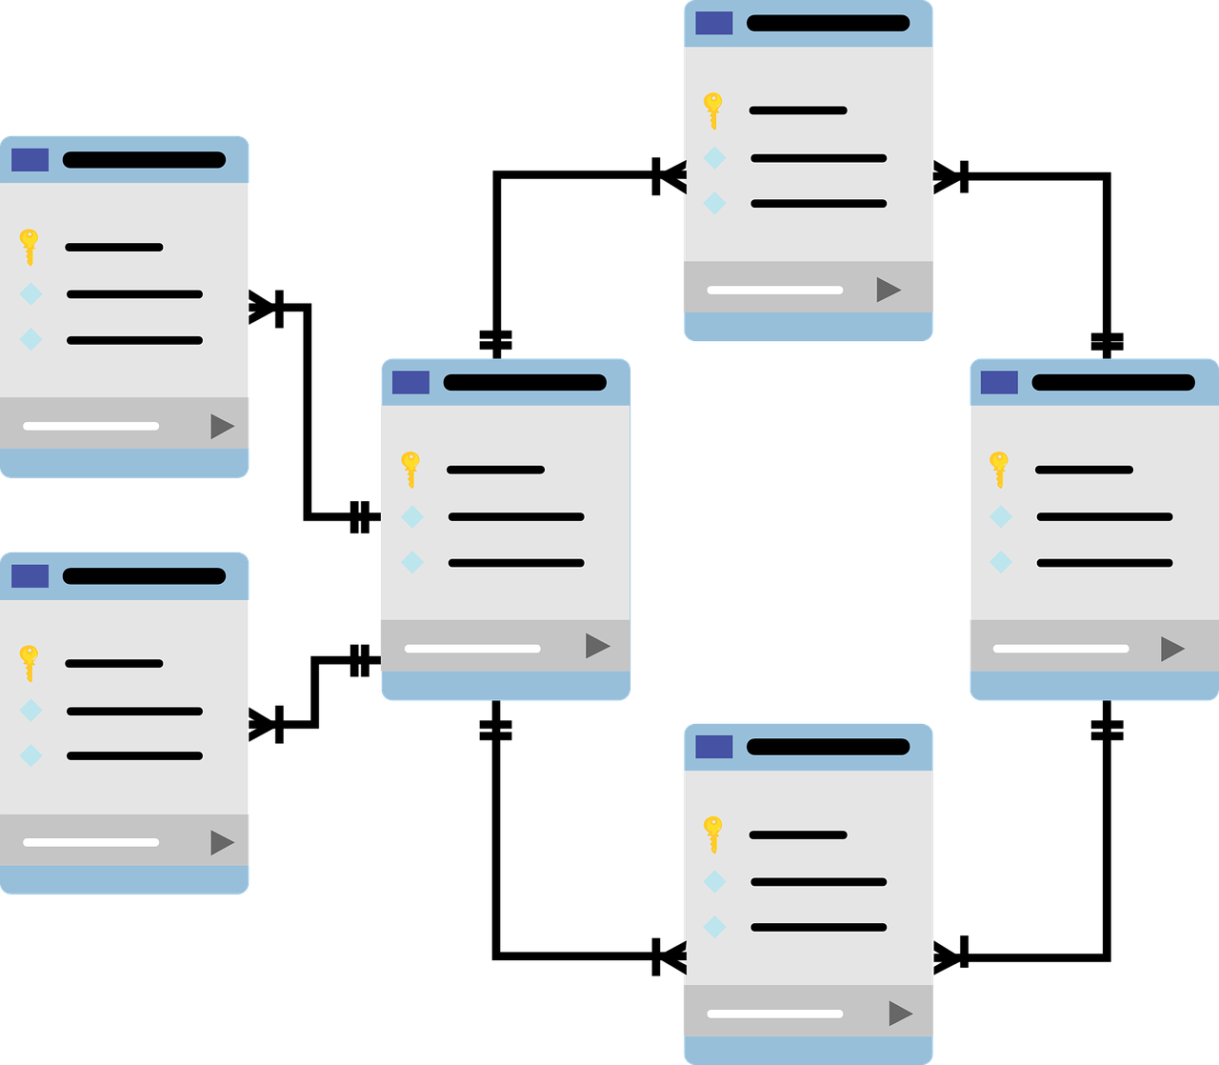
Import & transform
Data Prep

Slide 11
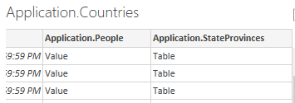
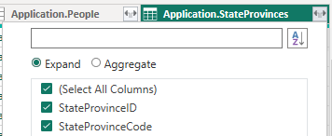
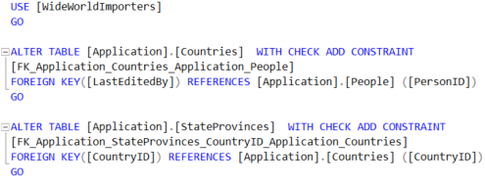
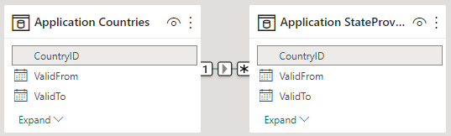
Foreign keys
Tables connected by an FK automatically pulled
Expand during Transform
Saves needing to bring the table in manually
Otherwise manually add w/ a Relationship
Always shoot for simplicity

Slide 12
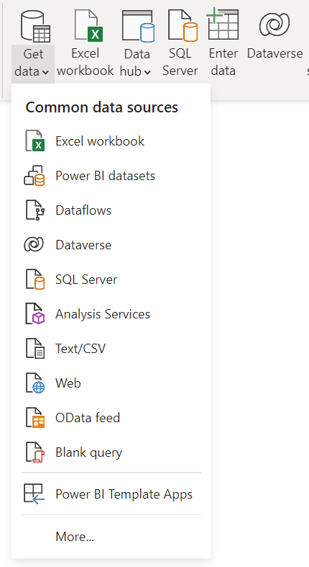
Importing Data
Power BI Supports 160+ Unique Data Source Types
Import Data
Pulls the data into memory stored within the file
Removes the need for direct access to the dataset
Preferred approach
Direct Query
Requires a direct connection to the data sources
Not ideal when needing to work offline from non-local sources
More performant when working with larger data sets
Heavily restricted on robust features
Examples: Calculated columns, relationships, certain visuals

Slide 13
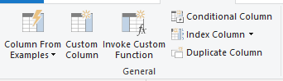
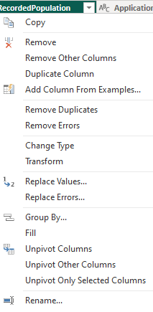
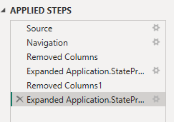
Key Cleanup Actions
Table Management
Custom Column
Index Column
Column Management
Remove Other Columns
Replace values
Rename
Remove Duplicates
Filter Values
Remove Empty “Blank”
Change Tracking: Series of steps representing all transformations on the select dataset
Add and remove steps
View changes made at each
Gear indicates additional options

Slide 14
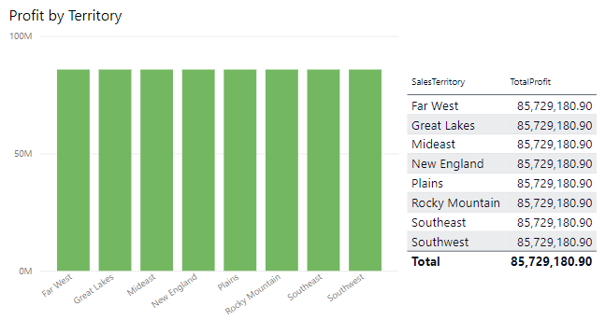
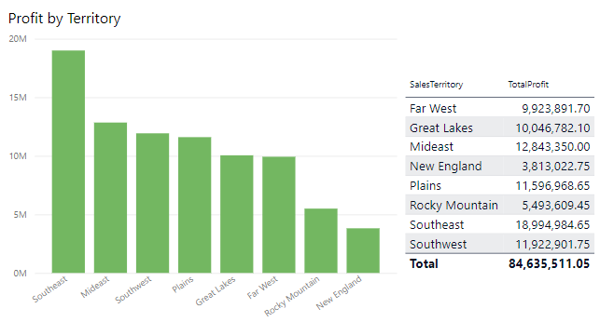
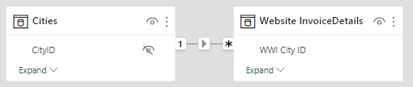
relationships
Without Relationship
Definition: How tables in a model correlate to each other.
Most noticeable when creating visuals with columns from multiple tables
Causes unexpected results when missing
Example: SELECT Website.InvoiceDetails.TotalProfit GROUP BY Application.Cities.SalesTerritory
With Relationship

Slide 15
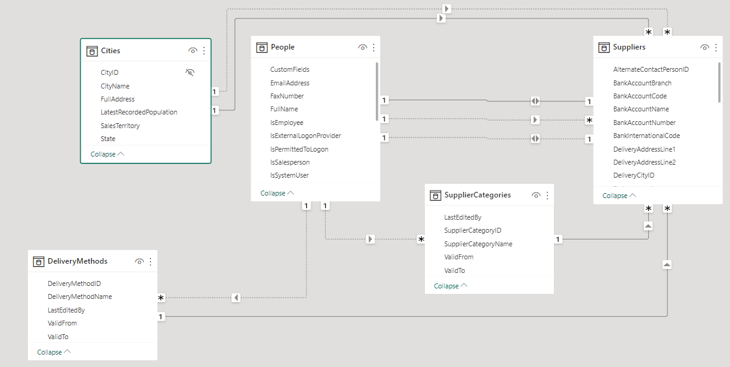
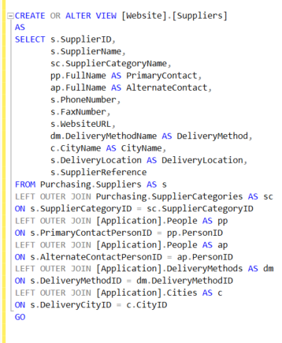
relationships vs Views
Always shoot for readability over complexity. Leverage a view at least when the relationships start to spiderweb.

Slide 16
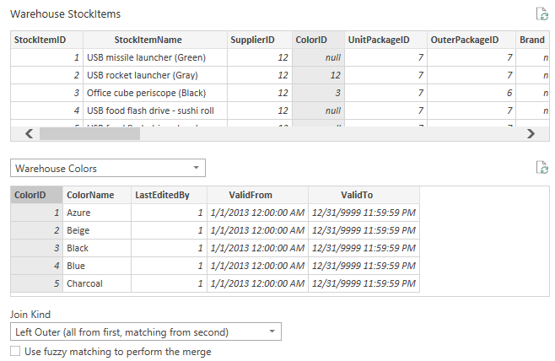
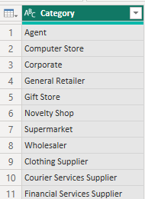
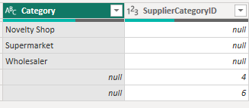
Combining Queries
Merge
Serves as a Join between two tables
Great for OUTER joins – Notice NULL values
INNER join clears out all NULL or missing values
Append
Serves as a type of UNION
Only combines like column names
Builds out other columns as needed
Matching Columns
Non-Matching Columns
Notes:
Stock items color id

Slide 17

Visualization
Appealing & Functional Design

Slide 18
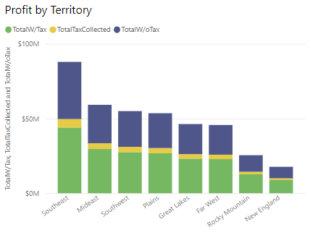
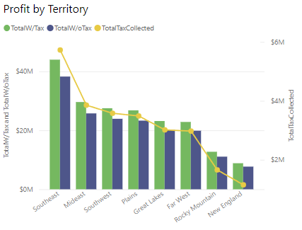
Line & Column Charts
The data being analyzed will clearly trend towards one over the other.
Stacked
Clustered

Slide 19
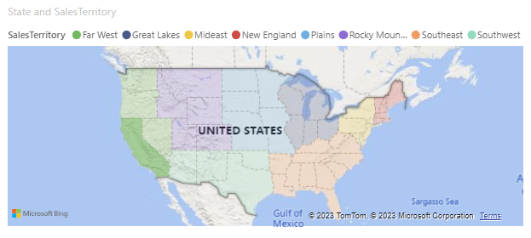
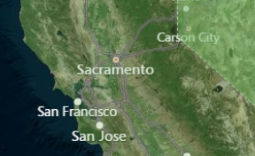
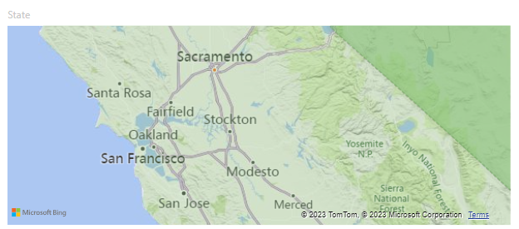
Maps
Definition: Visual representation of location information
Pairs well with other visuals as a filter
Highly Customizable
Geographic
Fully interactive
More format options than Shape Map
Doesn’t support custom maps
Details such as borders not available
Shape Map
Basic country outline
Out of the box state/county country maps
Import custom map JSON for granular details
Customize borders and gradients
Demo later

Slide 20
Slicers Date Table
Definition: A robust filter mechanism
Crucial when dealing with a large dataset
Control visibility and synchronization
Data type dependent options
Each list filters down based upon the other slicer selections
Include multiple columns to create an ordered hierarchy
Definition: A sequential, generated table of date values
Single source of truth for date breakdown
One place to maintain composite date keys
MMM-YYYY
QTR-YY
Supports turning off the time intelligence setting
Generated by a “New Table” script
Can rely on min/max of an existing date column

Slide 21

Words to the wise
I Wish I’d Known Them Sooner

Slide 22
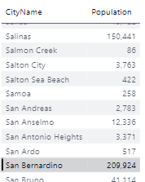
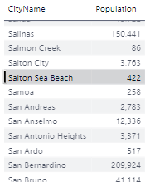
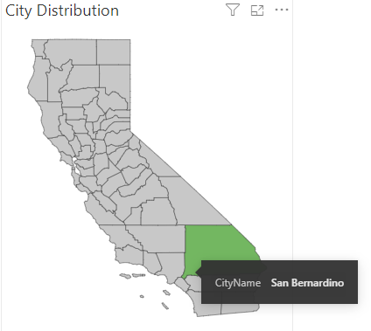
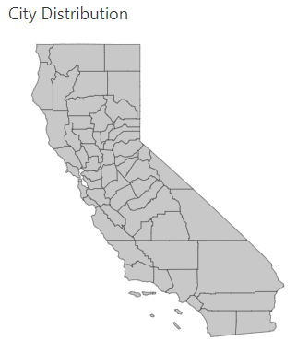
Visual behavior
Example: This custom state visual uses County not City
False positive
City of San Bernadino is also the name of a county
Keep In Mind:
Unique customization by visual type
Take the time to get familiar with them as you need them
Triple check the data. Trust, but verify.
False Positives
Data may appear to line up, but it’s just coincidence
Use multiple visual types
View interactions and compare numbers
Uncover missing relationships
Get insight into unexpected results

Slide 23
Hidden Gems
Hide Reports
Prevents certain reports from showing in navigation panel
Good for visual tooltips & drill-through targets
Informational Icons
Use an icon or shape to display help text
Set text as a measure
Hide Header Icons
Format Visual > Header Icons
Removes the extra buttons
Edit Multiple Visuals at Once
Format visual settings
Combine Shapes
See the pie chart
Outline shapes
Hide information
Column & Measure Tools
Data Type Management
Sort by Column
Visual Tooltips
Special report with a key value
Displays a pop-up visual
Drill-through
Navigate to a report based on field
Filters the destination by that context
View as Table
Translates a visual into a data table

Slide 24


Technical Demo

Slide 25


